Slide 1
Introduction to
Data Engineering
June 26, 2018

Slide 2
Course Outline
Relational databases
Relational model
Relationships
Constraints
Indexing
Stored procedures
Normalization
SQL
History / Alternatives
Design
Syntax
Data Marts
OLAP Vs. OLTP
Star schema
Snowflake schema
Tidy data
Principles
Benefits
Tidying messy data

Slide 3
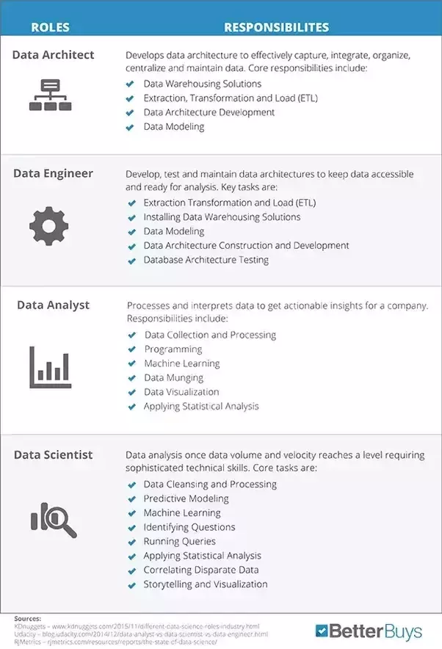
Data Science Roles

Slide 4
D2D Data Science Roles and Tools
Analyst
Visualization / Reports
Tableau & MSTR
Engineer ‘’N
Databases xxx
SQL, ETL xxx
xxx
Scientist
Analytics /
Statistics
R & Python
Data
Cleaning
Data
Cleaning
& Math
Data
Cleaning
& Manipulation

Slide 5
Relational Databases
Relational databases like MySQL, PostgreSQL and SQLite3 represent and store data in tables and rows.
Relational databases use Structured Querying Language (SQL)
Good for applications that involve the management of several transactions
The structure of a relational database allows you to link information from different tables through the use of foreign keys, which are used to uniquely identify any atomic piece of data within that table.
Other tables may refer to that foreign key, so as to create a link between their data pieces and the piece pointed to by the foreign key.
Comes in handy for applications that are heavy into data analysis.

Slide 6
Relational Databases (Cont.)
A relational database at its simplest is a set of tables used for storing data. Each table has a unique name and may relate to one or more other tables in the database through common values.
A table in a database is a collection of rows and columns. Tables are also known as entities or relations.
A row contains data pertaining to a single item or record in a table. Rows are also known as records or tuples.
A column contains data representing a specific characteristic of the records in the table. Columns are also known as fields or attributes.
A relationship is a link between two tables (i.e., relations). Relationships make it possible to find data in one table that pertains to a specific record in another table.

Slide 7
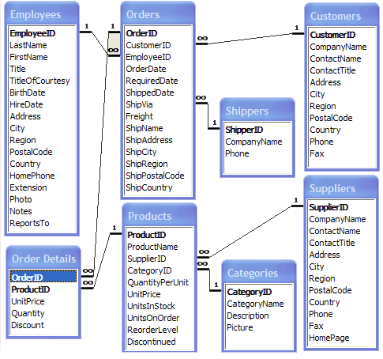
Example of Relational Database
Primary Key
Foreign Key
Relationship
Composite Primary Key

Slide 8
Datatypes
Each of a table's columns has a defined datatype that specifies the type of data that can exist in that column, for example:
String
Variable Character (can define character set, i.e. ASCII)
BLOB (Binary Large Object)
Computer code, e.g. JSON
Text, etc.
Numeric can be in a form of
Integer (small, big, medium)
Double (fixed, floating)
Large Numeric
Logical
Boolean
Various formats for date and time
Unfortunately, datatypes vary widely between databases and analytical tools

Slide 9
Operators
Operator Description Example
+ Addition - Adds values on either side of the operator a + b Subtraction - Subtracts right hand operand from left hand operand a - b
* Multiplication - Multiplies values on either side of the operator a * b
/ Division - Divides left hand operand by right hand operand b / a
% Modulus - Divides left hand operand by right hand operand
and returns remainder b % a

Slide 10
Constraints
Constraints are used to specify rules for the data in a table
Constraints are used to limit the type of data that can go into a table to ensure the accuracy and reliability
Constraints can be column level or table level
The commonly used constraints are:
NOT NULL - Ensures that a column cannot have a NULL value
UNIQUE - Ensures that all values in a column are different
PRIMARY KEY - A combination of a NOT NULL and UNIQUE Uniquely identifies each row in a table
FOREIGN KEY - Uniquely identifies a row/record in another table
CHECK - Ensures that all values in a column satisfies a specific condition
DEFAULT - Sets a default value for a column when no value is specified
INDEX - Used to create and retrieve data from the database very quickly

Slide 11
Data Integrity
The following categories of data integrity exist with each RDBMS:
Entity Integrity: There are no duplicate rows in a table.
Domain Integrity: Enforces valid entries for a given column by restricting the type, the format, or the range of values.
Referential integrity: Rows cannot be deleted, which are used by other records.
User-Defined Integrity: Enforces some specific business rules that do not fall into entity, domain or referential integrity.

Slide 12
Indexing
Indexes are used to retrieve data from the database very fast
The users cannot see the indexes, they are just used to speed up searches/queries
Updating a table with indexes takes more time than updating a table without (because the indexes also need an update)
Create indexes on columns that will be frequently searched against!
Indexes can be unique or not unique
Recommend unique indexes

Slide 13
Database Normalization
The concept of Normalization was introduced in 1969 by Edgar F. Codd as an integral part of his relational model
Basic objective was to permit data to be queried and manipulated using a "universal data sub-language" grounded in first-order logic (“If X is Socrates and X is a man, then Socrates is a man”)
Has multiple states / forms
Objectives of First Normal Form
Free the collection of relations from undesirable insertion, update and deletion dependencies
Reduce the need for restructuring the collection of relations, as new types of data are introduced, and thus increase the life span of application programs
Make the relational model more informative to users
Make the collection of relations neutral to the query statistics, i.e. query performance measurements

Slide 14
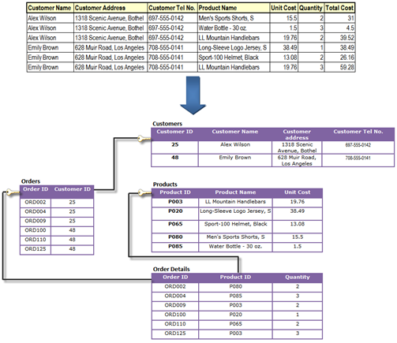
Database Normalization Example
Question: Does it go far enough?
What if I want to know customers in same city?

Slide 15
Popular Databases
Commercial
Oracle is the most popular relational database. It runs on both Unix and Windows. It used to be many times more expensive than SQL Server and DB2, but it has come down a lot in price.
SQL Server is Microsoft's database and, not surprisingly, only runs on Windows. It has only a slightly higher market share than Oracle on Windows machines. Many people find it easier to use than Oracle.
IBM's DB2 was one of the earliest players in the database market. It is still very commonly used on mainframes and runs on both Windows and Unix.
Popular Open Source Databases
Until recently, PostgreSQL was the most popular open source database until that spot was taken over by MySQL. It is certainly a featureful and robust database management system and a good choice for people who want some of the advanced features that MySQL doesn't yet have.
Because of its small size, its speediness, and its very good documentation, MySQL has quickly become the most popular open source database. MySQL is available on both Windows and Unix. It catches up with PostgreSQL functionality.
DSVD is using MySQL and MS SQL Server

Slide 16
Brief History of SQL Structured Query Language
In 1970, E. F. Codd published "A Relational Model of Data for Large Shared Data Banks," an article that outlined a model for storing and manipulating data using tables
Shortly after, IBM began working on creating a relational database
Between 1979 and 1982, Oracle (then Relational Software, Inc.), Relational Technology, Inc. (later acquired by Computer Associates), and IBM all put out commercial relational databases
By 1986 they all were using SQL as the data query language.
In 1986, the American National Standards Institute (ANSI) standardized SQL
This standard was updated in 1989, in 1992 (called SQL2)
In 1999 called SQL3
In 2003 called SQL 2003
In 2006 called SQL 2006
In 2008 called SQL 2008
Standard SQL is sometimes called ANSI SQL. All major relational databases support this standard but each has its own proprietary extensions

Slide 17
SQL Statements
Database Manipulation Language (DML) statements are used to work with data in an existing database. The most common DML statements are:
SELECT
INSERT
UPDATE
DELETE
Database Definition Language (DDL) statements are used to structure objects in a database. The most common DDL statements are:
CREATE
ALTER
DROP
Database Control Language (DCL) statements are used for database administration. The most common DCL statements are:
GRANT
DENY (SQL Server Only)
REVOKE

Slide 18
Some Basics
Comments: the standard SQL comment is two hyphens (--). However, some databases use other forms of comments as shown in the table below.
Example -- Comment # Comment /* Comment */
ANSI YES NO NO
SQL Server YES NO YES
Oracle YES NO YES
MySQL YES YES YES
Whitespace is ignored in SQL statements. Multiple statements are separated with semi-colons. The two statements in the sample below are equally valid.
SELECT * FROM Employees;
SELECT *
FROM Employees;
SQL is not case sensitive. It is common practice to write reserved words in all capital letters. User-defined names, such as table names and column names may or may not be case sensitive depending on the operating system used.

Slide 19
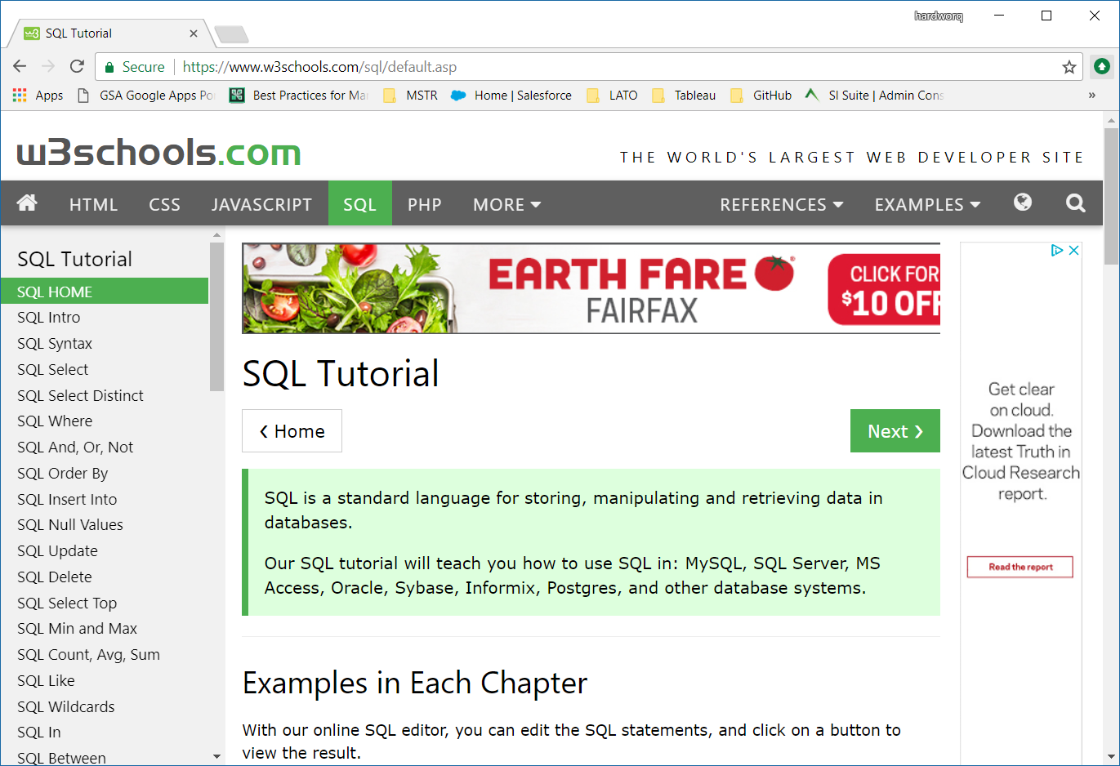
How to Learn SQL
https://www.webucator.com/tutorial/learn-sql/simple-selects/introduction-the-northwind-database-reading.cfm#tutorial
Uses Microsoft Northwind database incl. in Access
https://www.w3schools.com/sql/default.asp
More inclusive: offers MySQL, Oracle, and MS Access specifics
You will get a certificate after passing a quiz

Slide 20
MySQL Workbench
MySQL is an open source relational database that is cross platform
MySQL supports multiple storage engines which greatly improve the server performance tuning and flexibility
MySQL server can be administered using a number of server access mysql tools which include both commercial and open source products:
phpMyAdmin - cross platform web based open source server access tool
SQLYog - targeted at the windows platform, desktop commercial server access tool
MySQL workbench - cross platform open source server access tool.
MySQL workbench is an integrated development environment for MySQL server
It has utilities for database modeling and designing, SQL development and server administration
MySQL workbench is included in DSVD
https://www.guru99.com/introduction-to-mysql-workbench.html

Slide 21
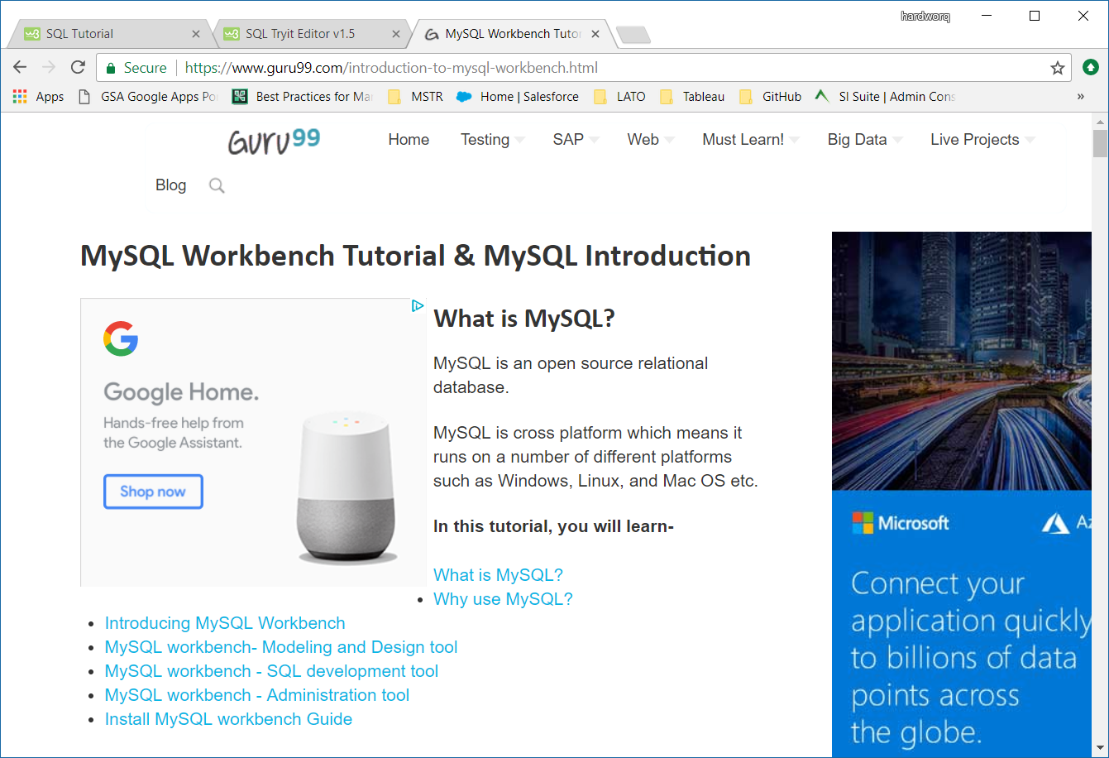
MySQL Workbench Tutorial

Slide 22
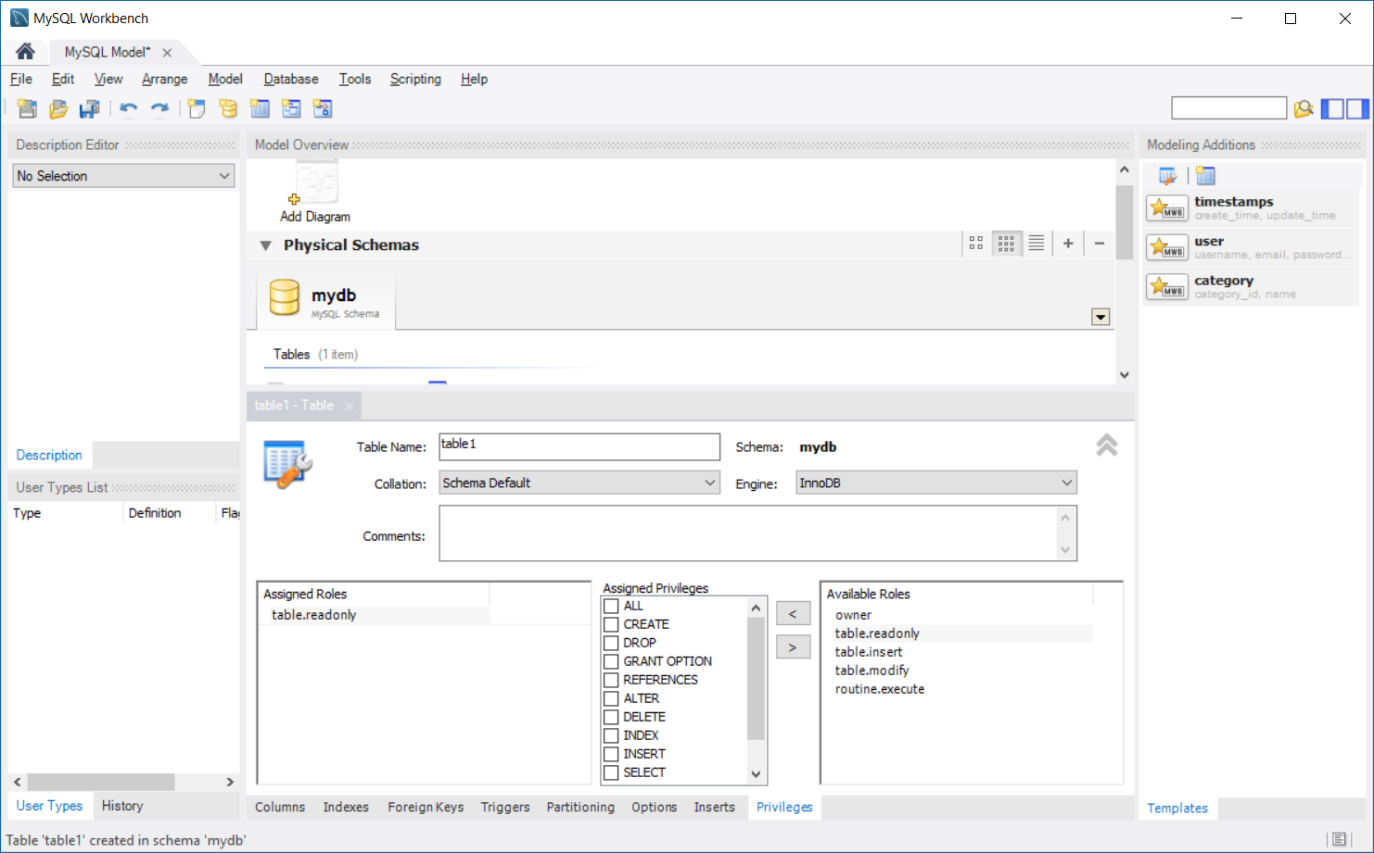
MySQL Workbench Desktop

Slide 23

Import CSV with MySQL Workbench
Step 1: Create table
CREATE TABLE discounts (
id INT NOT NULL AUTO_INCREMENT,
title VARCHAR(255) NOT NULL,
expired_date DATE NOT NULL,
amount DECIMAL(10 , 2 ) NULL,
PRIMARY KEY (id)
);
Step 2: Open the table and click on Import Button

Slide 24
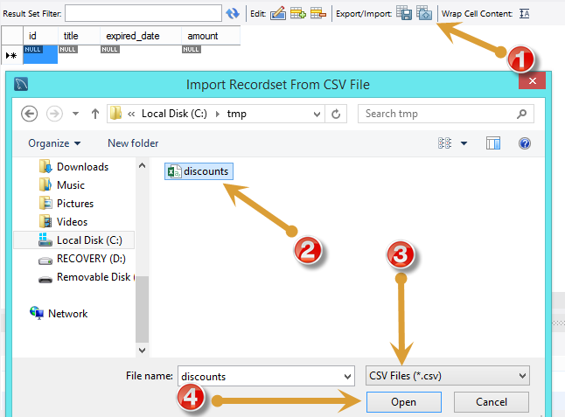
Import CSV with MySQL Workbench (Cont. 1)
Step 3: Follow the dialog

Slide 25
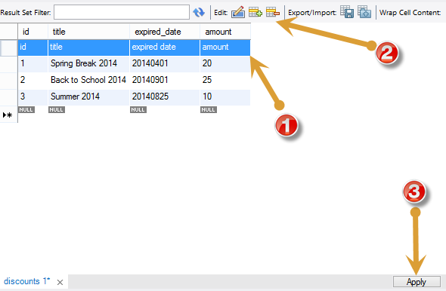
Import CSV with MySQL Workbench (Cont. 2)
Step 4: Review the data

Slide 26
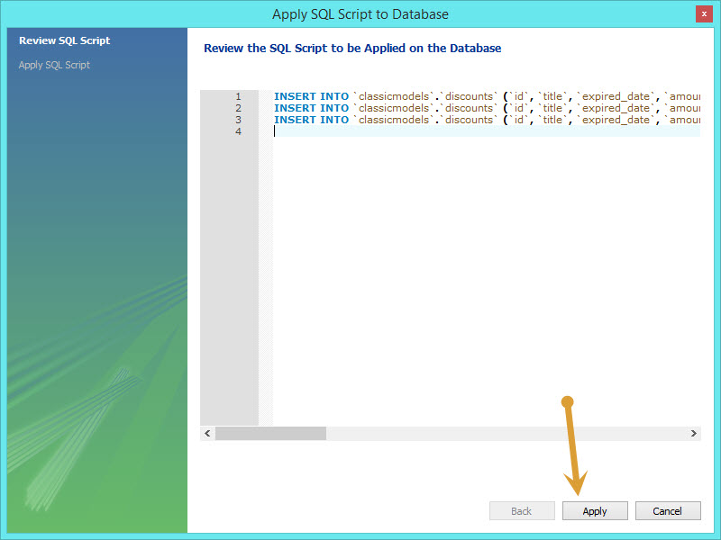
Import CSV with MySQL Workbench (Cont. 3)
Step 5: Upload the data

Slide 27
OLTP Vs. OLAP
What is a prime use of your database?
Operational – OLTP, or
Analytical – OLAP
OLTP (On-line Transaction Processing)
Large number of short on-line transactions (INSERT, UPDATE, DELETE)
The main emphasis for OLTP systems is put on very fast query processing, maintaining data integrity in multi-access environments and an effectiveness measured by number of transactions per second.
OLTP database is used to store transactional databases is the entity model
OLAP (On-line Analytical Processing)
Relatively low volume of transactions
Queries are often very complex and involve aggregations
For OLAP systems fast response time is desired
OLAP applications are widely used by Data Mining techniques.
In OLAP database there is aggregated, historical data, stored in multi-dimensional schemas (usually star schema)

Slide 28
Star Schema
Star schema is the simplest style of data mart schema
The most widely approach used to develop data warehouses and dimensional data marts
The star schema consists of one or more fact tables referencing any number of dimension tables
The star schema gets its name from the dimension tables surrounding it representing the star's points
Fact table contains
Numeric data, and
Foreign keys to dimension tables
Dimension tables contain context / descriptive info for the numeric data

Slide 29
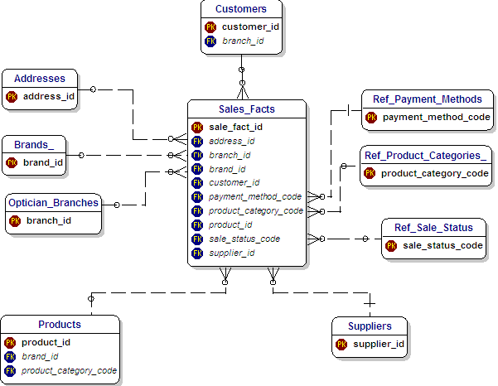
Star Schema Diagram

Slide 30
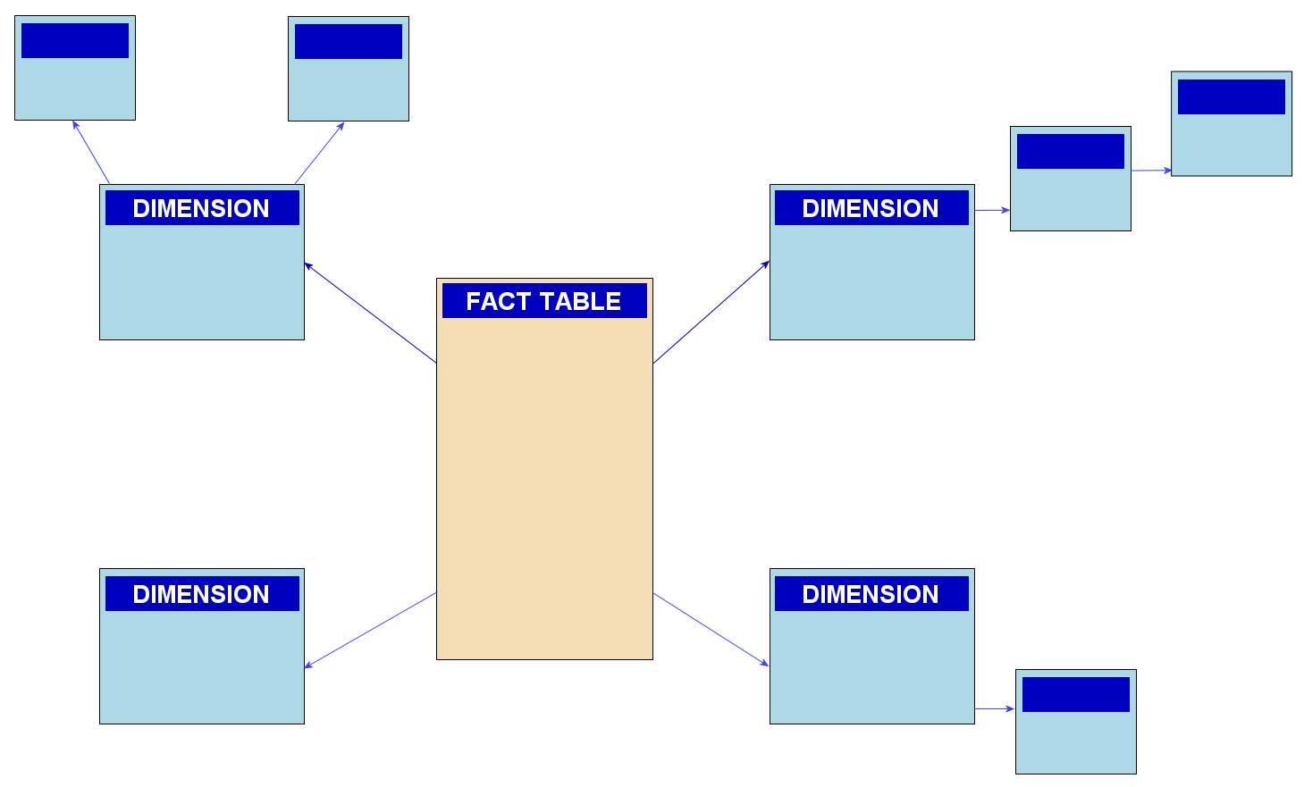
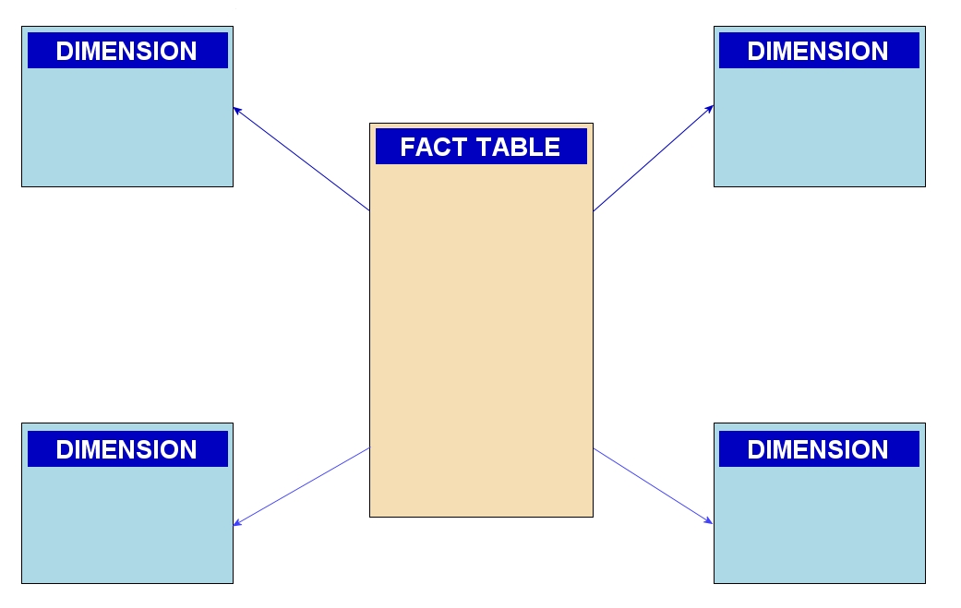
Snowflake Schema
The snowflake schema is expansion of the star schema
In the snowflake schema, dimensions are normalized into multiple related tables, whereas the star schema's dimensions are de-normalized with each dimension represented by a single table
Star Schema
Snowflake Schema

Slide 31
Snowflake Vs. Star
Snowflake is highly normalized
Snowflake better enforces data integrity then star schema
Requires less space
The primary disadvantage of the snowflake schema is that the additional levels of attribute normalization adds complexity to source query joins
Snowflake schemas, in contrast to flat single table dimensions, have been heavily criticized
The goal of an efficient and compact storage of normalized data comes at the significant cost of poor performance when browsing the joins requires down highly normalized dimension
Review Slide 11

Slide 32
Database view
A result set of a stored query
Takes little space to store (query only)
Hides complexity of the data
Materialized (pre-executed) view provides high performance
View has following advantages over tables
Can represent a subset of the data
Can join multiple table into single virtual table
Can aggregate (sum, average, etc.) data
Can support drilling

Slide 33
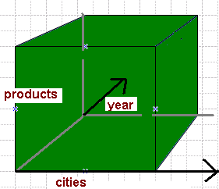
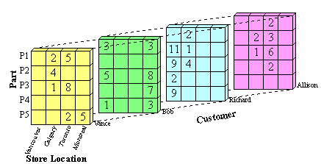
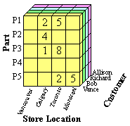
OLAP Cubes
A multi-dimensional array (3-dimensions shown)
An extension of a spreadsheet / table
Used to represent data along some measure of interest
An extension of SQL to allow navigation along a dimension

Slide 34
Pandas Vs SQL https://pandas.pydata.org/pandas-docs/version/0.22.0/comparison_with_sql.html
SQL manipulates data in a database
You can write stored procedures in SQL
Pandas is not a data store, it is an in-memory data storage tool
This makes Pandas fast, but the data does not persist
(You can use Pandas to access database w/ SQL, but that would equal to using SQL)
Pandas is better with complex analysis
SQL is better suited for joins
Recommendation
Use SQL to extract and upload data
Use Pandas to tidy the data

Slide 35
Tidy Data
Tidy data principles
Each variable forms a column
Each observation (tuple) forms a row
Each type of observational unit (dimension) forms a table
Five most common problems with messy datasets
Column headers are values, not variable names.
Multiple variables are stored in one column.
Variables are stored in both rows and columns.
Multiple types of observational units are stored in the same table.
A single observational unit is stored in multiple tables.

Slide 36
Tidying data in R and Python tutorial https://www.superdatascience.com/wrangling-data-r-python/
Wrangling the same data set with R and then Python
Instructions how to
Load data
Bind rows
Select / rename columns
Change data types
Create data frames
Remove duplicates
Group by and summarize
Join data frames
Visualize

Slide 37
Example of Messy Data Pew data: relationship between income and religion
1: Columns are not names of the variable
religion <$10k $10-20k $20-30k $30-40k $40-50k $50-75k
Agnostic 27 34 60 81 76 137
Atheist 12 27 37 52 35 70
Buddhist 27 21 30 34 33 58
Catholic 418 617 732 670 638 1116
Don’t know/refused 15 14 15 11 10 35
Evangelical Prot 575 869 1064 982 881 1486
Hindu 1 9 7 9 11 34
Historically Black Prot 228 244 236 238 197 223
Jehovah’s Witness 20 27 24 24 21 30
Jewish 19 19 25 25 30 95
2: Income categories turned into column names resulting in loosing info: cannot compute average income per religion

Slide 38
Tidied Pew Data
religion income noOfPeople
Agnostic <$10k 27
Agnostic $10-20k 34
Agnostic $20-30k 60
Agnostic $30-40k 81
Agnostic $40-50k 76
Agnostic $50-75k 137
Agnostic $75-100k 122
Agnostic $100-150k 109
Agnostic >150k 84
Agnostic Don’t know/refused 96
Question: what else can we do?
Review E. F. Codd principles on slide 10

Slide 39
pandas.melt
pandas.melt(frame, id_vars=None, value_vars=None, var_name=None, value_name='value', col_level=None)
“Unpivots” a DataFrame from wide format to long format, optionally leaving id variables set
Parameters :
frame : DataFrame
id_vars : tuple, list, or ndarray
value_vars : tuple, list, or ndarray
var_name : scalar, if None uses frame.column.name or ‘variable’
value_name : scalar, default ‘value’
col_level : scalar, if columns are a MultiIndex then use this level to melt

Slide 40
Tidying Pew Data with Pandas
pew_raw = pd.read_csv('D:\\Acuity\\D2D\\Data Science Training\\Python\\pew_raw.csv')
pew_long = pd.melt(pew_raw,
["religion"],
var_name="income",
value_name="count")
pew_long = pew_long.sort_values(by=["religion"])
pew_long.head(10)
pew_avg_cat = pd.read_csv('D:\\Acuity\\D2D\\Data Science Training\\Python\\pew_avg_cat.csv')
pew_long_avg = pd.melt(pew_avg_cat,
["religion"],
var_name="avg.income",
value_name="count")
pew_long_avg = pew_long_avg.sort_values(by=["religion"])
pew_long_avg.head(10)

Slide 41
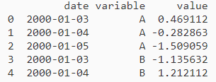
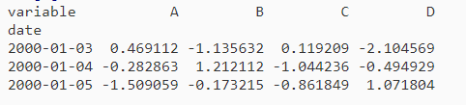
Reshape by Pivoting
Data is often stored in CSV files or databases in so-called “stacked” or “record” format
However, a preferred format for time-series analysis is
To reshape the data into this form, we use the DataFrame.pivot() method
https://pandas.pydata.org/pandas-docs/stable/reshaping.html

Slide 42
Reshape by pivoting in Pandas
# Reshape by pivoting
DateVarValRaw = pd.read_csv('D:\\Acuity\\D2D\\Data Science Training\\Python\\DataVariableValue.csv')
DateVarValPiv = DateVarValRaw.pivot(index='date', columns='variable', values='value')

Slide 43
Pandas multi-level Indexing
tips = sns.load_dataset('tips')
# can aggregate
tips_smoker = tips.groupby('smoker').mean()
tips_smoker
tips_smoker.index
tips_smoker.reset_index()
tips_smoker_time = tips.groupby(['smoker','time']).mean()
tips_smoker_time
tips_smoker_time.index
tips_smoker_time.swaplevel()
tips_smoker_time.unstack()
tips_smoker_time.unstack(level = 0)
tips_size = tips.groupby(['size', 'time']).mean()
tips_size
tips_count = tips.groupby(['size', 'time']).size()
tips_count
tips_size_smoker = tips.groupby(['size', 'smoker']).size()
tips_size_smoker
# explain what is size
tips_smoker_time.swaplevel()
tips_smoker_time.unstack()
tips_smoker_time.unstack(level = 0)
https://pandas.pydata.org/pandas-docs/stable/advanced.html

Slide 44
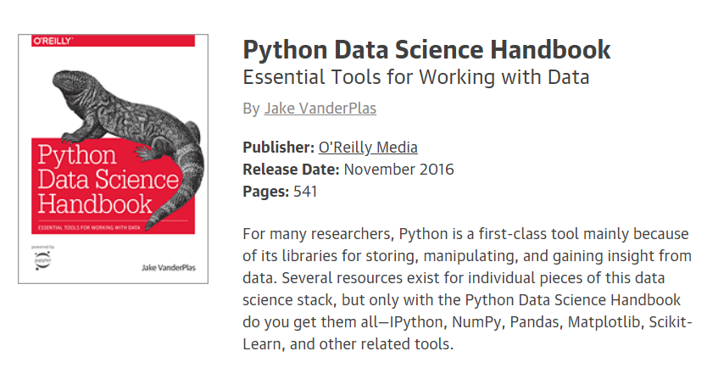
http://shop.oreilly.com/product/0636920034919.do
https://jakevdp.github.io/PythonDataScienceHandbook/
https://jakevdp.github.io/PythonDataScienceHandbook/03.10-working-with-strings.html
https://jakevdp.github.io/PythonDataScienceHandbook/03.09-pivot-tables.html
https://jakevdp.github.io/PythonDataScienceHandbook/04.14-visualization-with-seaborn.html

Slide 45
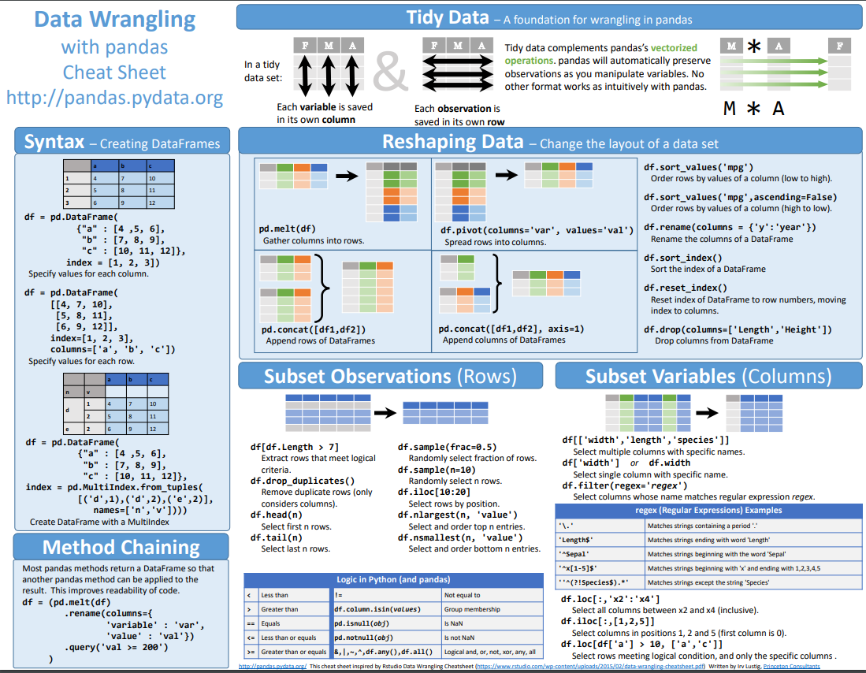
http://pandas.pydata.org/Pandas_Cheat_Sheet.pdf

Slide 46
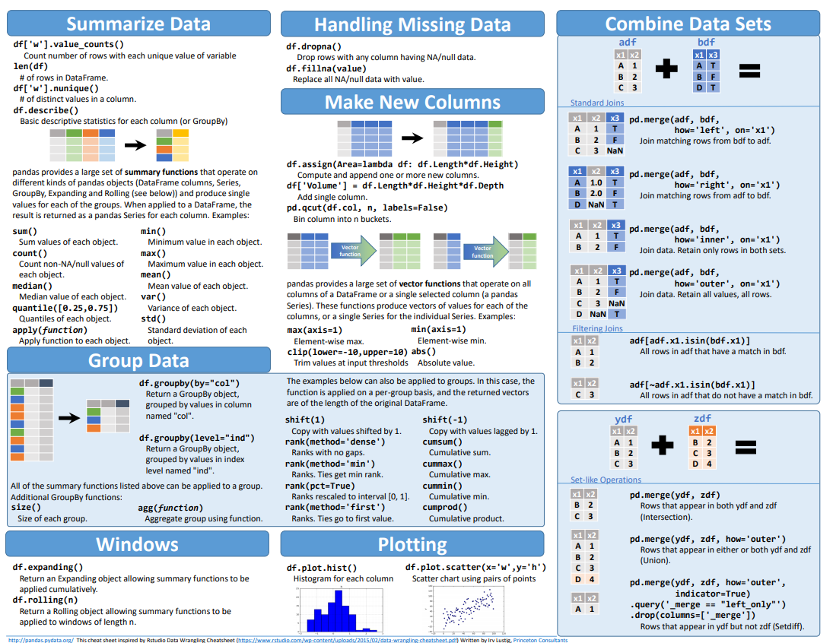
http://pandas.pydata.org/Pandas_Cheat_Sheet.pdf (Cont.)

Slide 47
Q & A

